Slide 1

Introducing Akka

Slide 2

Who is using Akka ?

Slide 3
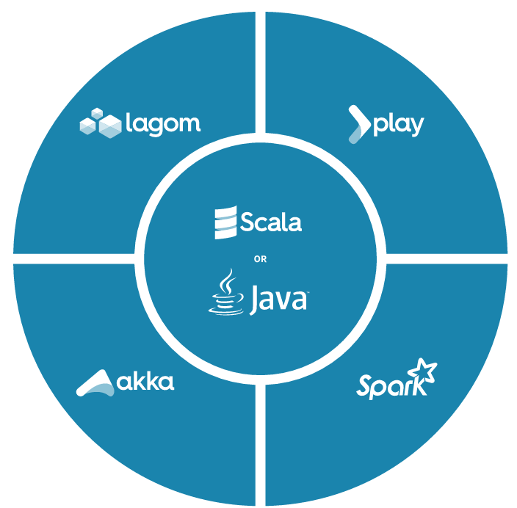
Lightbend Reactive Platform
reactive manifesto

Slide 4

What is Akka ?
is a toolkit and runtime for building highly concurrent, distributed, and resilient message-driven applications on the JVM. (Java/Scala)
Simpler concurrency
Simpler distribution
Simpler fault tolerance
akka.io

Slide 5
How to achieve that ?
Akka implements a unique hybrid:
Actor model
Supervisor hierarchies with “let-it-crash” philosophy
Location transparency
Persistence
Let’s talk about them one by one…

Slide 6

Shared-state concurrency
Shared-state concurrency means concurrent access to
shared mutable state guarded by locks,
which is HARD:
to write
to read
to test
to debug
to reason about

Slide 7

We need a better model
Locks are not easy to get right
race conditions
data corruption
deadlocks
livelocks
We need work at a higher abstraction level !!

Slide 8

Actor model (since 1973, Carl Hewitt)
Actor is the fundamental unit of computation that embodies:
Processing
Storage
Communication
In response to a message it receives, actor can:
Create more actors
Send messages to other actors
Designate the behavior to be used for the next message it receives
The actor model has been popularized by Erlang language

Slide 9
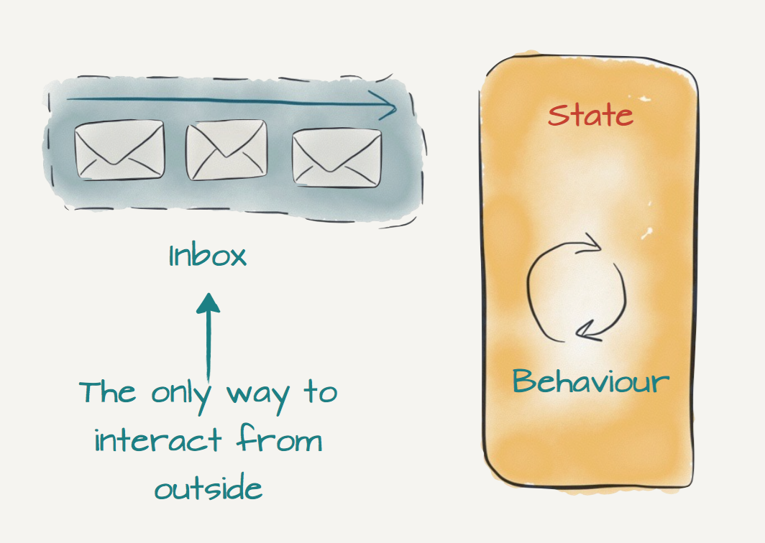
Akka actor
An actor is a container for State, Behavior, a Mailbox,
Child Actors and a Supervisor Strategy.
single execution flow model
no shared mutable state
asynchronous message passing
loose coupling
easy to test
lightweight (~2.5m per GB)
fast (~50m/s benchmark)
Message Delivery Reliability
at-most-once delivery, i.e. no guaranteed delivery
message ordering per sender–receiver pair

Slide 10
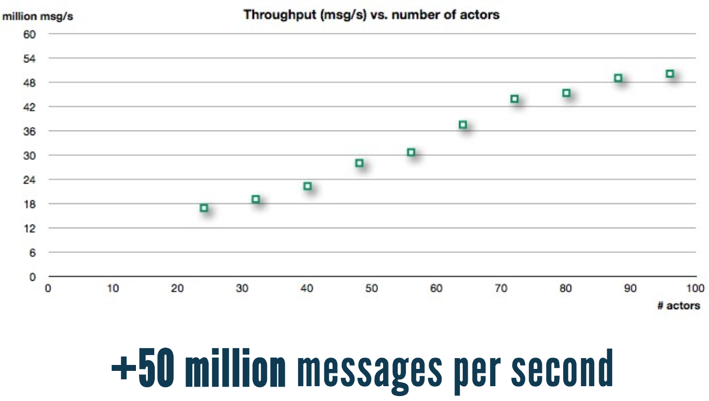
Throughput on a single machine
link-to-performance-test

Slide 11
Actor lifecycle

Slide 12
Concurrency in Akka
An Akka MessageDispatcher is what makes Akka Actors "tick",
it is the engine of the machine so to speak

Slide 13
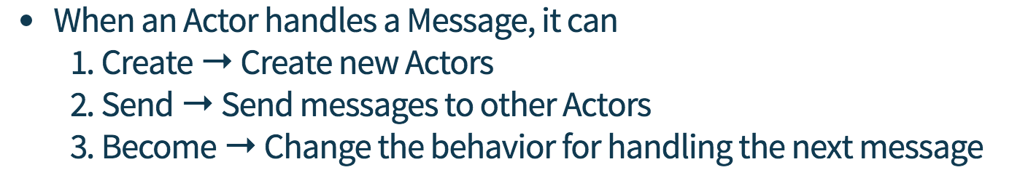
Akka actor core operations

Slide 14
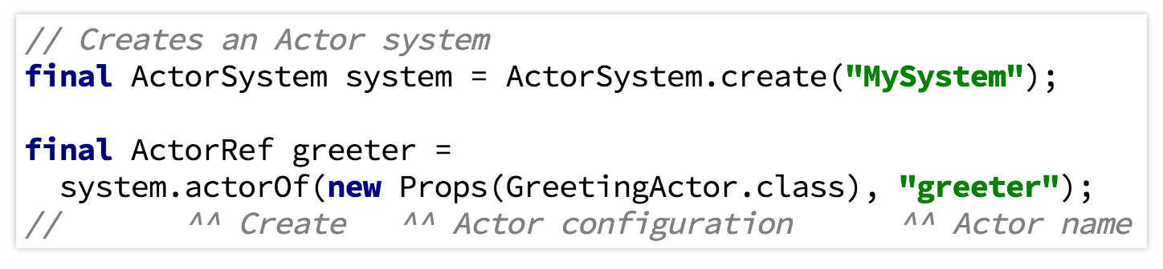
Create and send

Slide 15
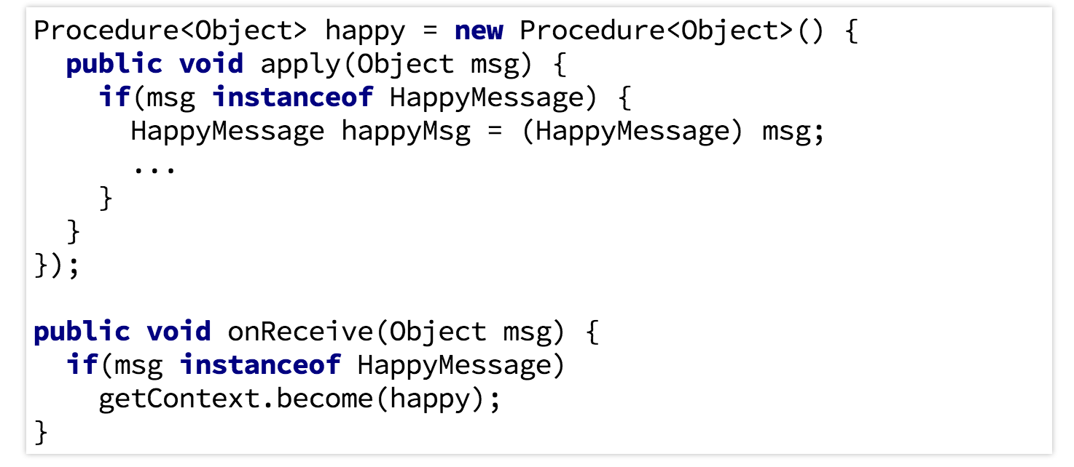
Become

Slide 16

Load Balancing

Slide 17
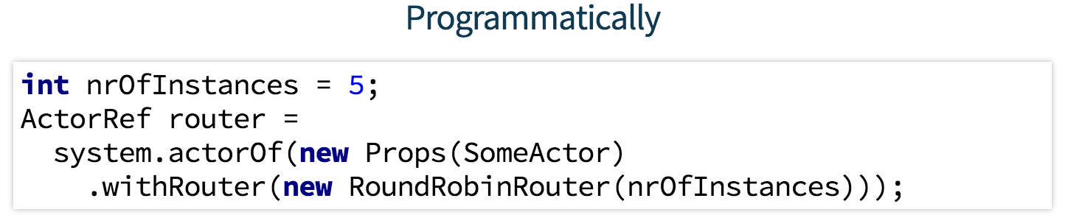
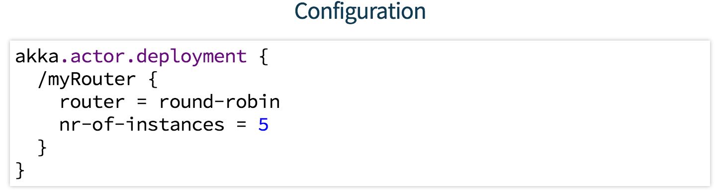
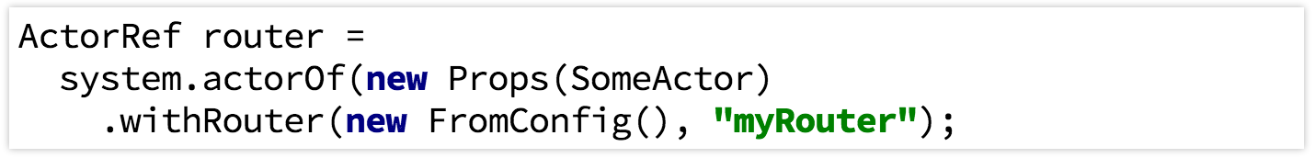
Routers

Slide 18
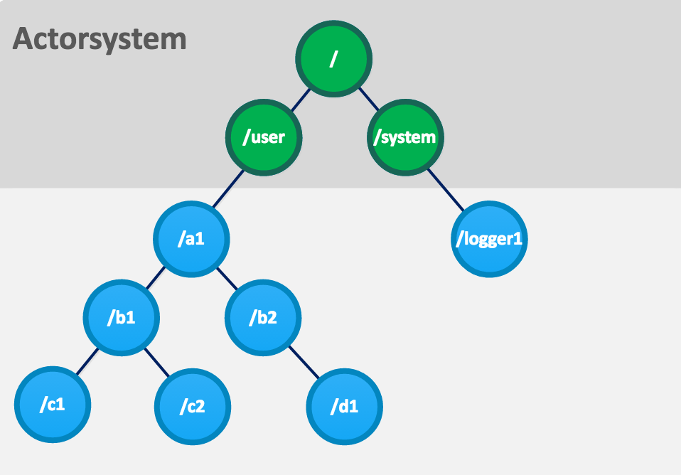
Actor System
One actor is no actor, they come in systems,
and they have to have addresses so that one
actor can send messages to another actor.

Slide 19
Actor references, paths and addresses

Slide 20
Supervisor strategy – “let it crash”

Slide 21
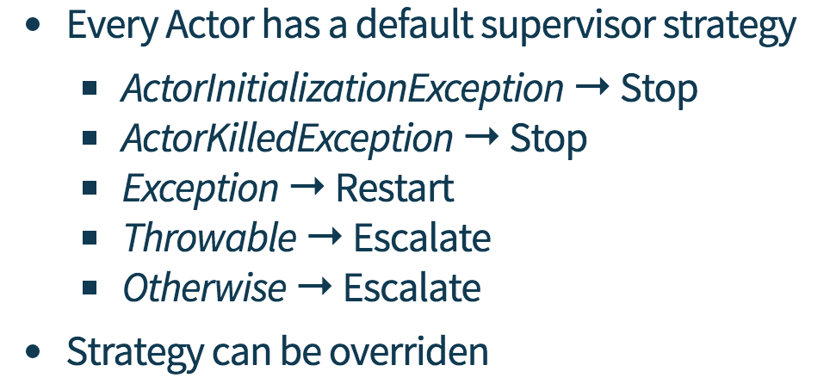
Supervisor strategy

Slide 22
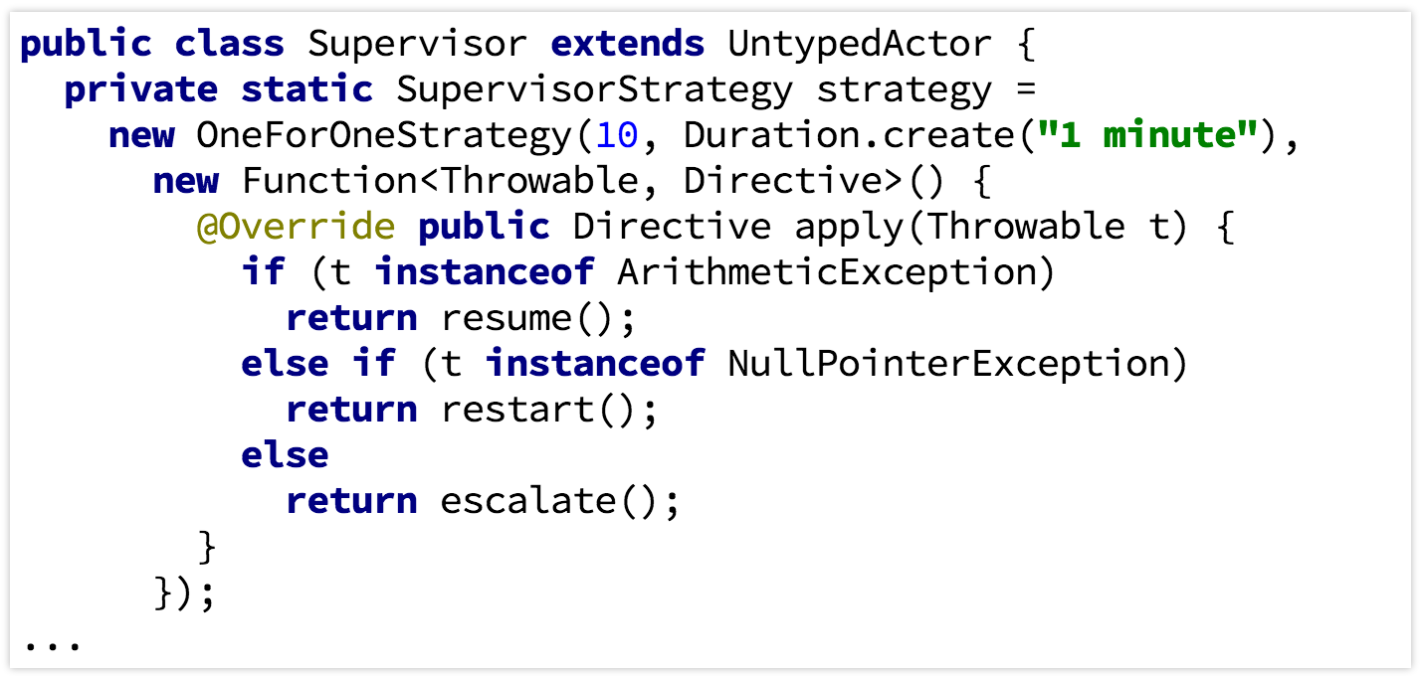
Override Supervisor strategy
One-For-One Strategy
All-For-One Strategy

Slide 23
Location Transparency

Slide 24
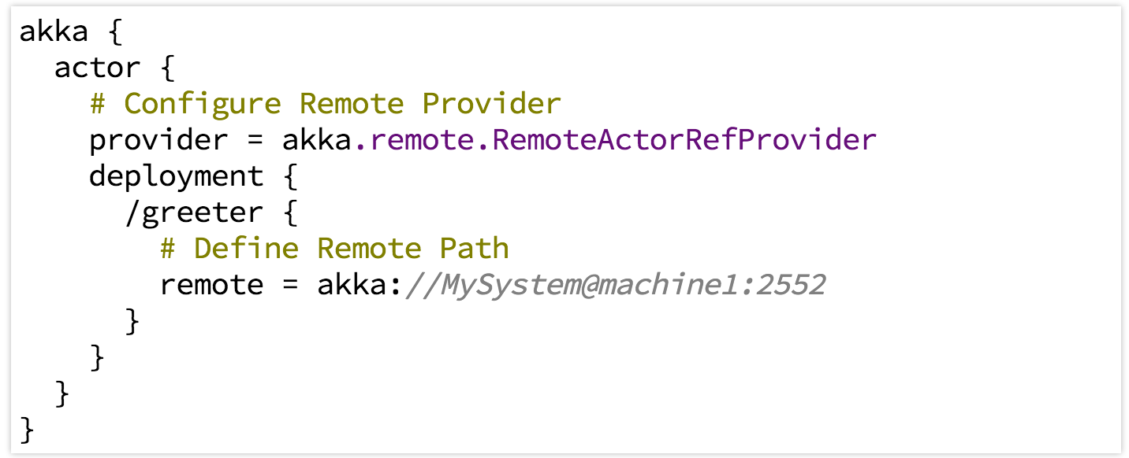
Creating Actors Remotely

Slide 25
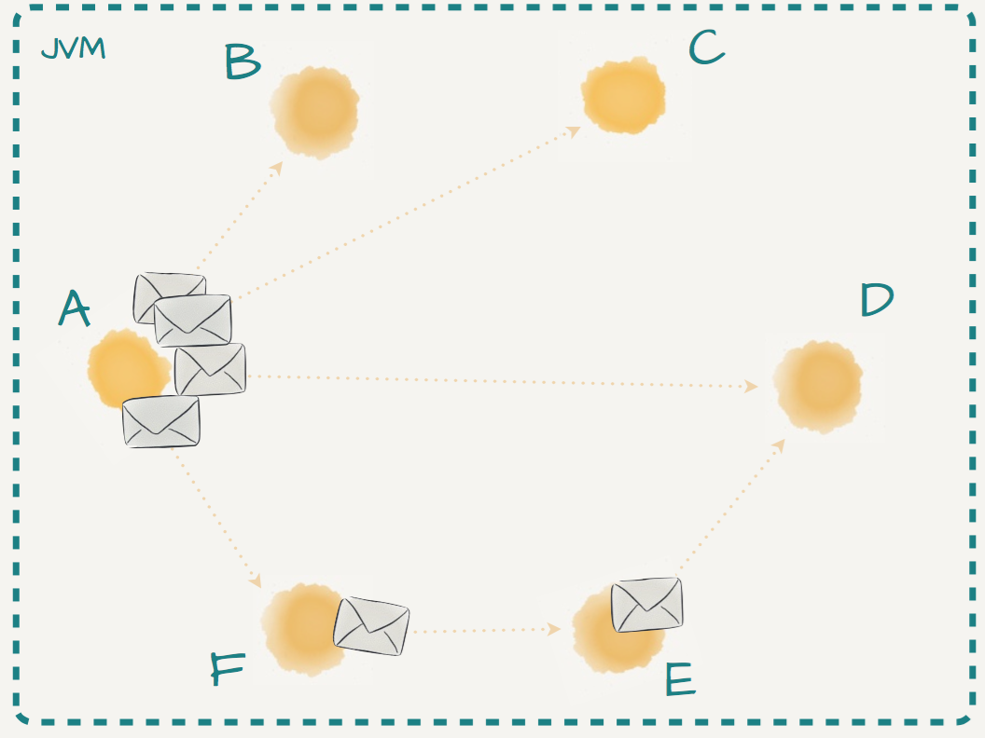
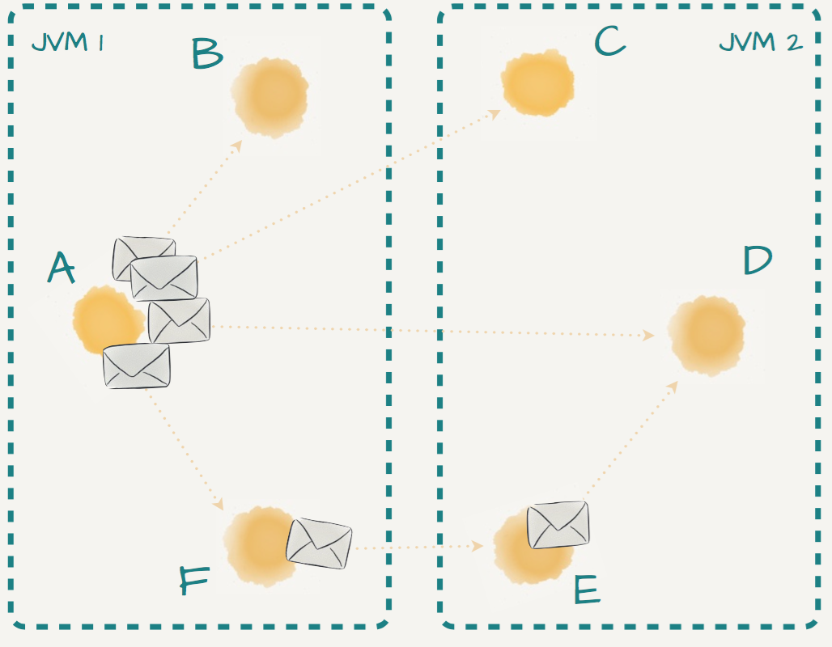
Distributed by default

Slide 26
Akka cluster
Akka clustering is built on top of akka remoting.
Akka Cluster provides a fault-tolerant decentralized peer-to-peer based cluster membership service with no single point of failure or single point of bottleneck. It does this using gossip protocols and an automatic failure detector.
Terms
node
seed nodes
cluster
leader
membership

Slide 27
Akka cluster
State Diagram for the Member States

Slide 28
Akka cluster
Features
Distributed Publish Subscribe in Cluster
Cluster Singleton
Cluster Sharding
Cluster Client
Issues
Unreachable node cause unstable cluster or split brain issue
Pub-sub lose messages when unreachable nodes exists

Slide 29
Akka persistence
Akka persistence enables stateful actors to persist their internal state so that it can be recovered when an actor is started, restarted after a JVM crash or by a supervisor, or migrated in a cluster.
Core concepts:
Event sourcing
Snapshot

Slide 30
Lightbend Activator
Lightbend Activator is a single download to get you started
building Reactive applications.
./activator –h
./activator ui
./activator list-templates
./activator new [name] [template-id]
To run it offline, add the options below
-Dactivator.checkForUpdates=false
-Dactivator.checkForTemplateUpdates=false

Slide 31
Resources
http://akka.io
http://letitcrash.com
http://www.lightbend.com
http://www.lightbend.com/activator/download

